Slide 1
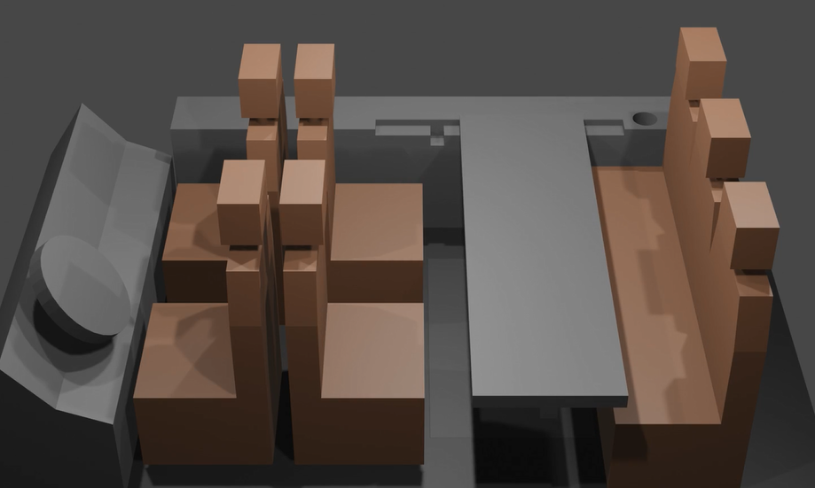
Workspace of the Future
Sarah Franko, Francisca Oseghale, Katharine Priu, Kayla Tolly

Slide 2
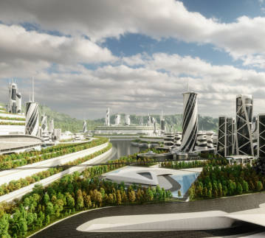
What is the Workspace of the Future?
A mobile workspace inside a luxury SUV
A future, ideally electric, version of the Lincoln Navigator will be able to have the backseat area converted to an office space in 3 steps:
Front seats slide forward to the dash
Second row seats rotate 180 degrees inwards to face the third row and move forwards towards the front seats
A table stowed in a floor compartment can be unfolded and used as a desk
The Workspace of the Future solves 3 common problems addressed on the next slides

Slide 3

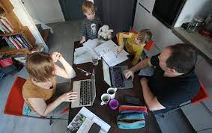
Problem 1
While working remotely, it is often difficult to find a distraction-free workspace
This could be due to a number of reasons, including
Thin walls and multiple people trying to work from home
Children and/or pets
No office space in the home

Slide 4
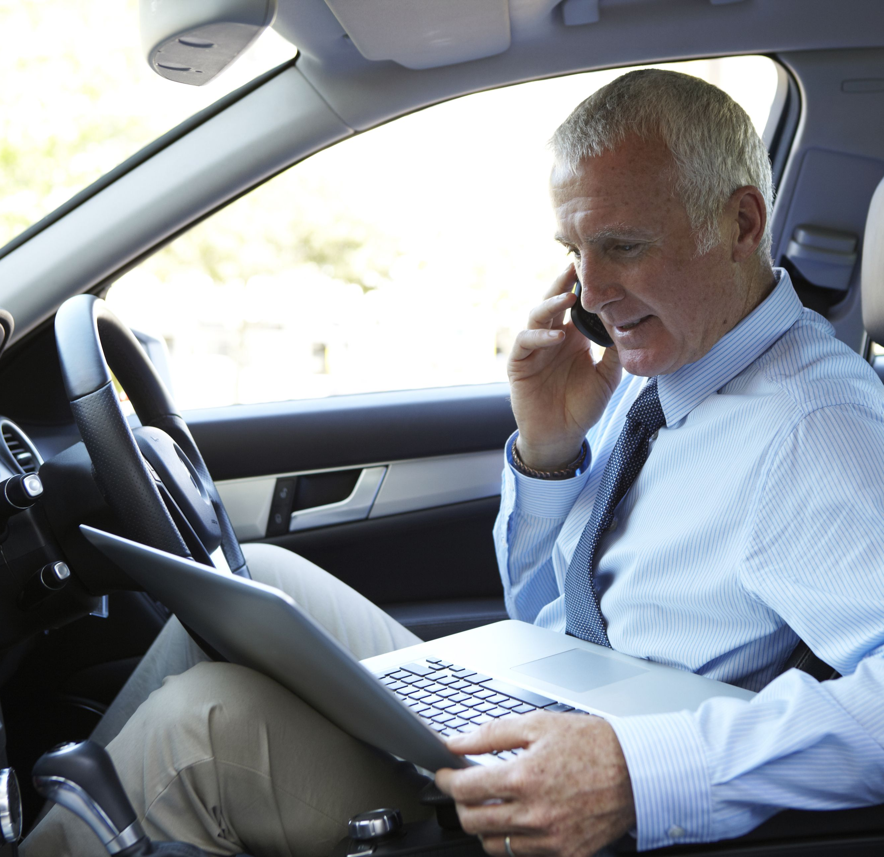
Problem 2
A busy lifestyle often leaves people needing to work outside of the home or office, and current vehicles do not provide a comfortably accessible work environment
Examples include:
Needing to get work done while waiting to pick up kids
Job requires driving around and working offsite
Working while traveling, such as a cross-country road trip

Slide 5

Problem 3
Since the pandemic, people working remotely have had a difficult time separating their work life from their home life, since they both live and work in the home
Studies have shown that people are less productive when they are working and sleeping in the same place
Never leaving the home is unhealthy mentally, as many feel trapped

Slide 6
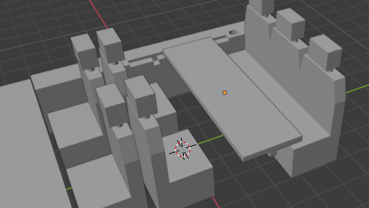
Workspace of the Future: the Rundown

Slide 7
Interior Cabin
Relatively spacious area
Interior similar to that of the current Navigator
Ample leg room between the 2nd and 3rd rows
Floor compartment between 2nd and 3rd rows to store the table leaf

Slide 8
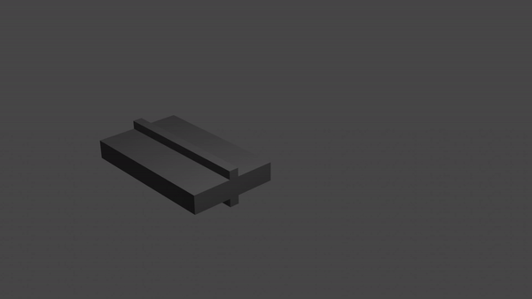
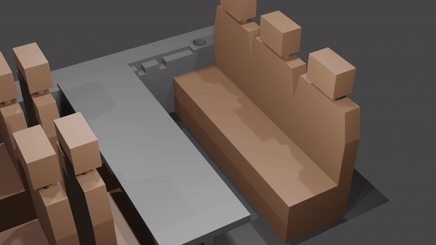
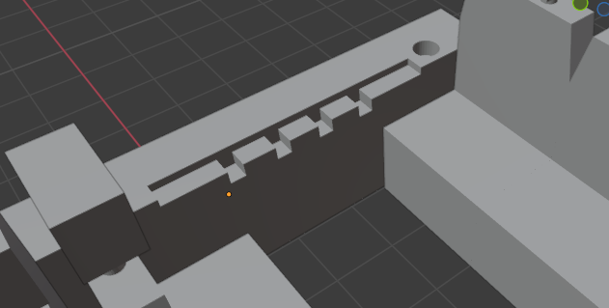
Desk
A foldable plastic leaf stowed in the floor between the second and third rows that can be unfolded to span the distance between two brackets on the walls of the vehicle.
The desk position will be adjustable in the x-axis using a system of notches to secure the table in the desired position either closer to or further away from occupant.
The width of the desk will accommodate a desktop computer with room for additional work.
The length of the desk will stretch between trim of the interior walls.

Slide 9
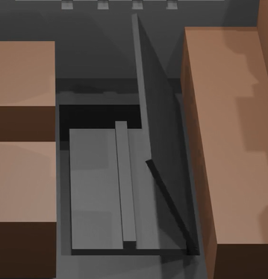
Floor Compartment
Between the 2nd and 3rd rows
Large enough to store the desk
Customer can also stow other items in compartment

Slide 10
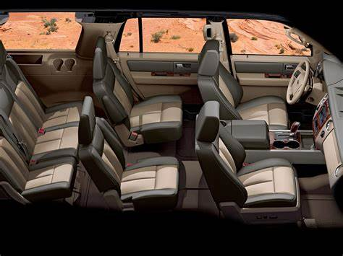
Seats
The 2R seats will operate as “swivel” seats that spin 180 degrees inwards to face the 3R seats
The seats will have foldable armrests to simulate the office chair feeling
There will be a seat locking mechanism at the base of the seat that secures the seat in place after transitioning from front facing to rear facing
The tracks for the 2R seats would have to be extended so the 2R seats can move to meet the front seats
After measuring the dimensions in the car, we determined that there is enough room for the 2R seats to rotate without trimming them down
Slides Forwards
Slides Forwards
Rotates 180 degrees
inwards
Slides Forwards
Slides Forwards

Slide 11
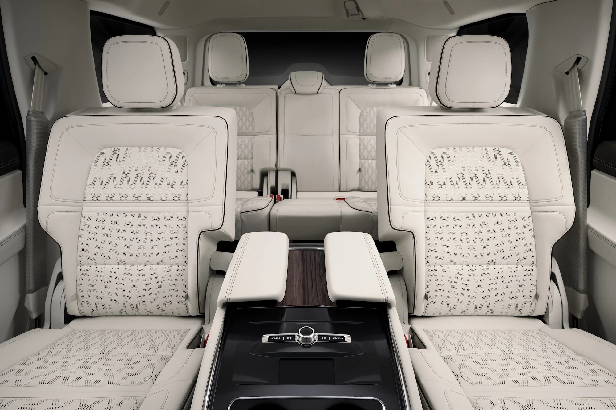
Seat Movement Process
4 step process:
Front seats move forward to meet the dash
2R seat backs fold forward to reduce space needed for rotation
2R seats can then rotate 180°
2R seats move forward to meet front seats
This process will be done mechanically instead of electrically
Electronic mechanisms could fail and lead to warranty issues
Note: console between 2R seats would be removed to allow for seat rotation

Slide 12
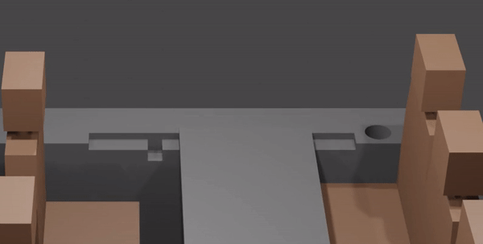
Webcast Screen
Screen that comes out of the side panel of the car using similar technology to that of roll-down windows
Screen is stored in side panel as default, but when a button is pressed it will rise in front of the window and provide a second screen for video conferencing, etc.
Research shows that adding a second screen can increase productivity up to 42%
Uses pre-existing technology (tablet like in front dash, mechanism as in current windows)

Slide 13
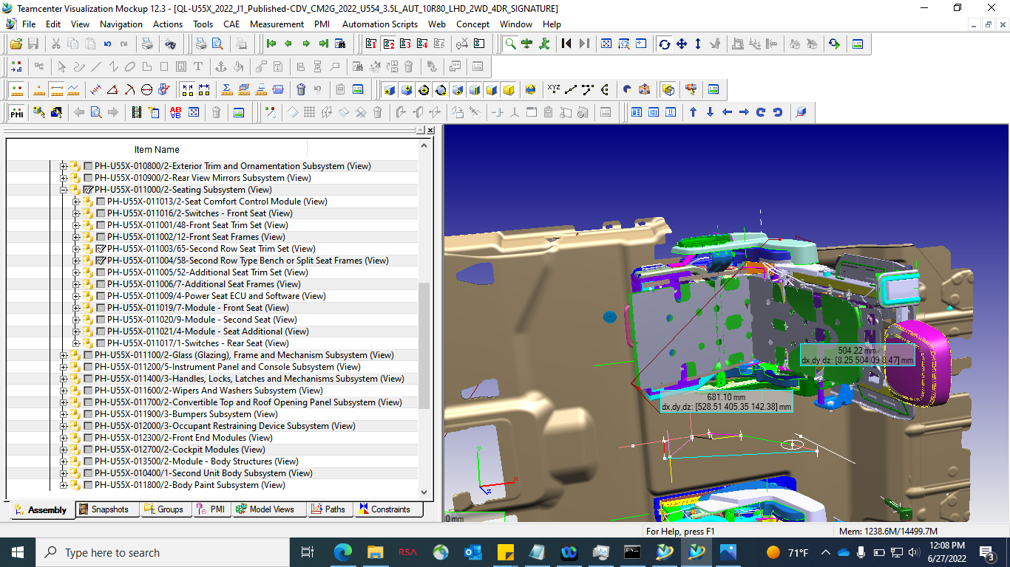
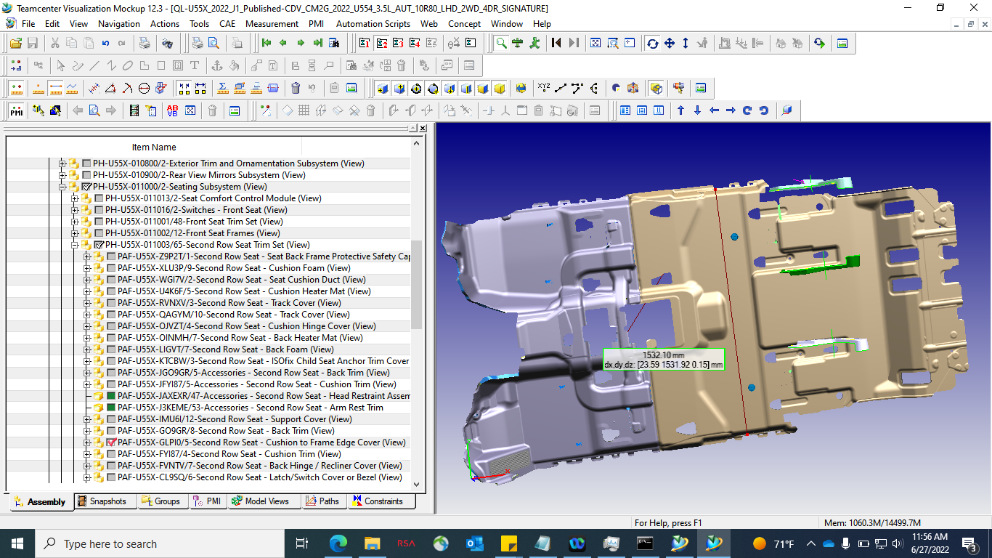
Feasibility
We measured the 2R seat dimensions, as well as the width of the interior cabin, in Teamcenter
The diagonal (maximum) dimension of the 2R seat is ~0.68m (assuming the seat back is pulled forward), while the interior cabin width is ~1.5m
Shows that both seats could rotate at the same time and still have room without adjusting the seat or cabin size
Measurements of 2R seat (above) and width of interior cabin (below)
2022 Navigator

Slide 14
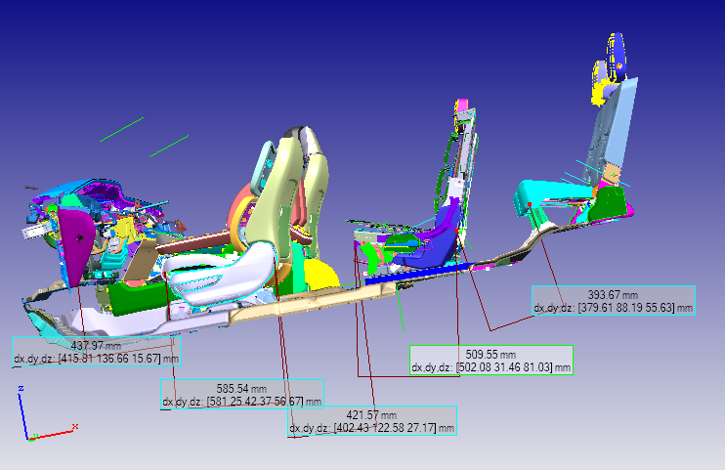
Feasibility cont.
Front seats can move forward ~0.4m
2R seats rotate and then can move back ~0.8m
Leaves ~1.2m between the 2R and 3R seats for table space, floor compartment, extra leg room, etc.
2022 Navigator

Slide 15
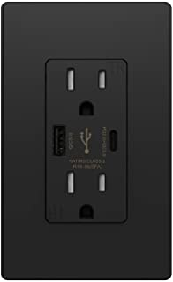
Additional Commodities
Greater accessibility to outlets, particularly between the second and third rows
Improved interior lighting system that reduces eye strain when working in dimly lit environments
Shades will be provided for all windows to reduce visibility from the outside of the vehicle when an occupant is working inside

Slide 16
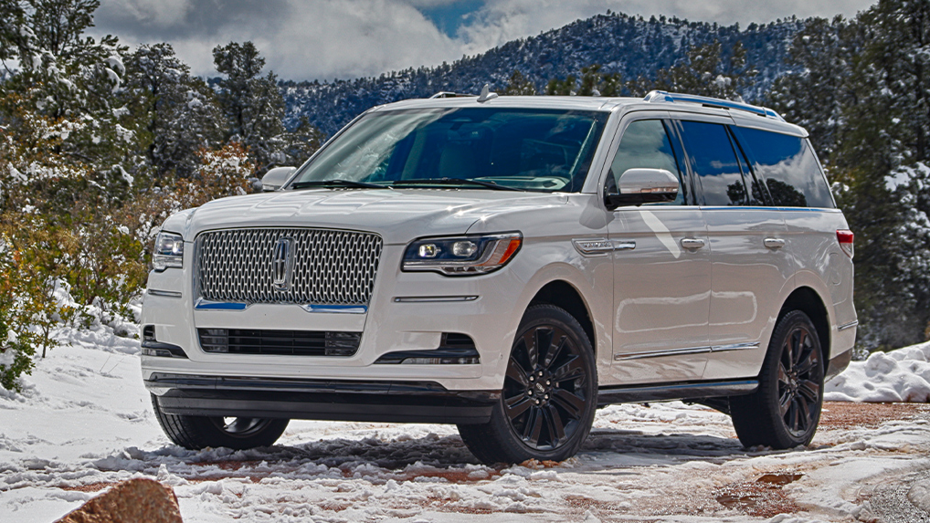
Benefits
Allow people to work comfortably from their car with easier accessibility to desk space
Improve the customer’s perception of working in their car so they view their vehicle as more of a welcoming office instead of a single purpose transportation vehicle.
A mobile office space available to the customer when their business takes them outside of the traditional office and home environments.
With the absence of distractions usually found at home, the user can be more focused and increase their productivity while working from the car.

Slide 17

Who can use the Workspace of the Future?
Anyone needing and/or wanting to work from their car!
Can accommodate both the individual and groups of up to 5 people

Slide 18

Survey Results
We surveyed 50 people about their opinions of working from their cars, and how they thought it could be improved. Of those 50 people,
88 % said they do not enjoy working in the current day automobile
69 % said working from their car could be improved if they had a desk
94 % said working from their car could be improved if they had more space
46 % said they would use this feature
We interviewed 4 Ford supervisors, who also supported the idea.
Our results indicate that there is a consumer base for the Workspace of the Future.

Slide 19
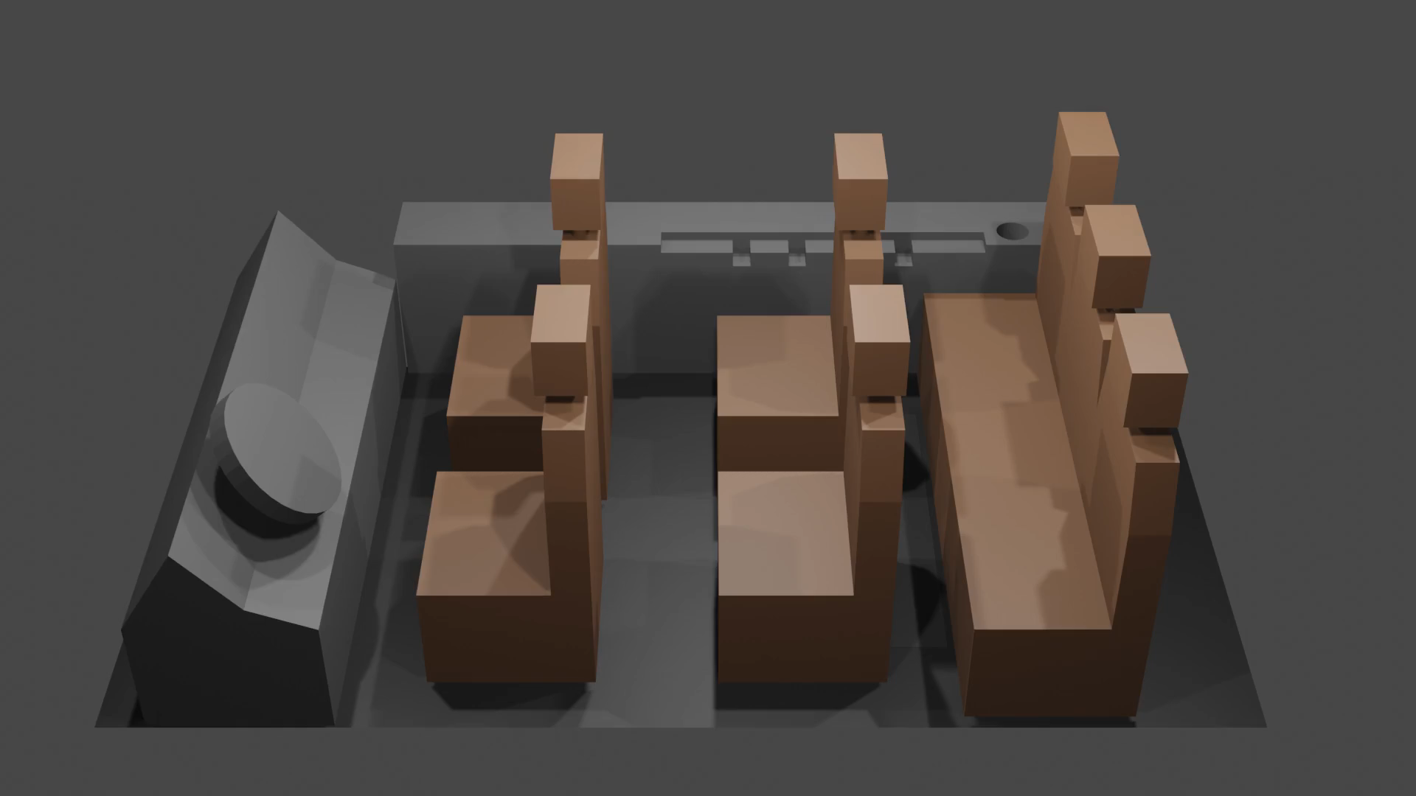
How it works (video)
https://youtu.be/poiVxaG7swI

